Slide 1

Non-linguistic Thinking as an Effective Tool for Innovation in Education
Leon Brânzan, Technical University of Moldova, https://fcim.utm.md/

Slide 2
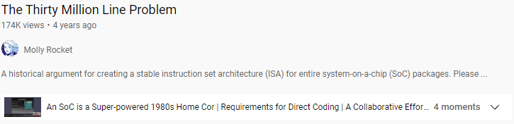
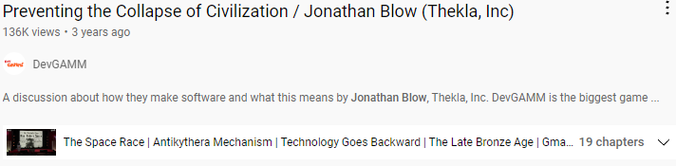
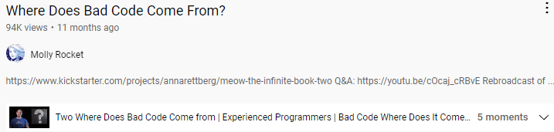
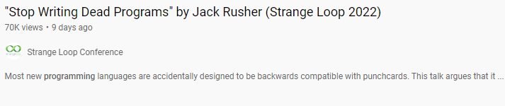
Is software getting worse?
“We are in the process of digging ourselves into an anachronism by preserving practices that have no rational basis beyond their historical roots in an earlier period of technological and theoretical development.”
Seymour Papert, 1980
<number>

Slide 3
Is software getting worse?
Are programmers getting worse?
Are the tools getting worse?
Are we teaching programming the wrong way?
<number>

Slide 4
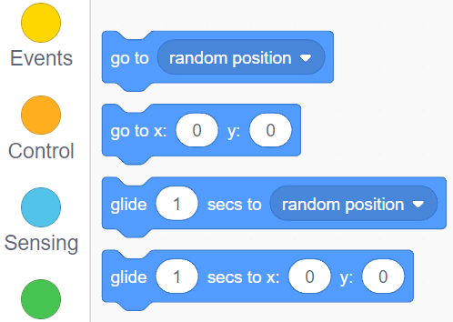
How programming is taught
.LC0:
.string "hello, world!"
main:
pushq %rbp
movq %rsp, %rbp
subq $32, %rsp
movl %edi, -4(%rbp)
movq %rsi, -16(%rbp)
movq %rdx, -24(%rbp)
movl $.LC0, %edi
movl $0, %eax
call printf
nop
leave
ret
#include <stdio.h>
void main(int argc, char *argv[], char *envp[])
{
printf("hello, world!");
}
<number>

Slide 5
Why learning how to program is hard
Programming languages should come last
Text should be used less
Specific skills and intuition should be developed early
<number>
<number>

Slide 6
Programming languages
3 + x = 5​
<number>

Slide 7
Programming languages
Python → C → Assembly → Machine code
Data-oriented > Object-oriented > Functional > Structured
x = j if a > b else k
x = a > b → j, k
int x = (a > b) ? j : k;
<number>

Slide 8
Textual form
Formal language =/= natural language
Cognitive load theory
Visual information processing vs. textual information processing
Reasoning and language processing are done in different parts of the brain
<number>

Slide 9
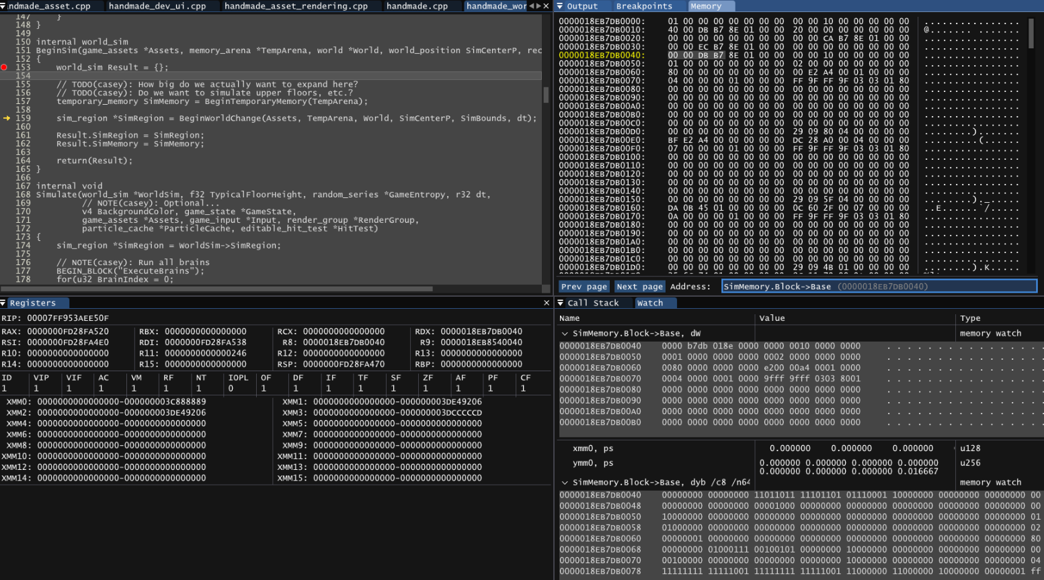
Specific set of skills
<number>

Slide 10
Solutions
Guiding the learning process with visual tools to promote inference and reflection
Choosing the right computational model
Developing engineering thinking early by teaching fundamental concepts first
<number>

Slide 11
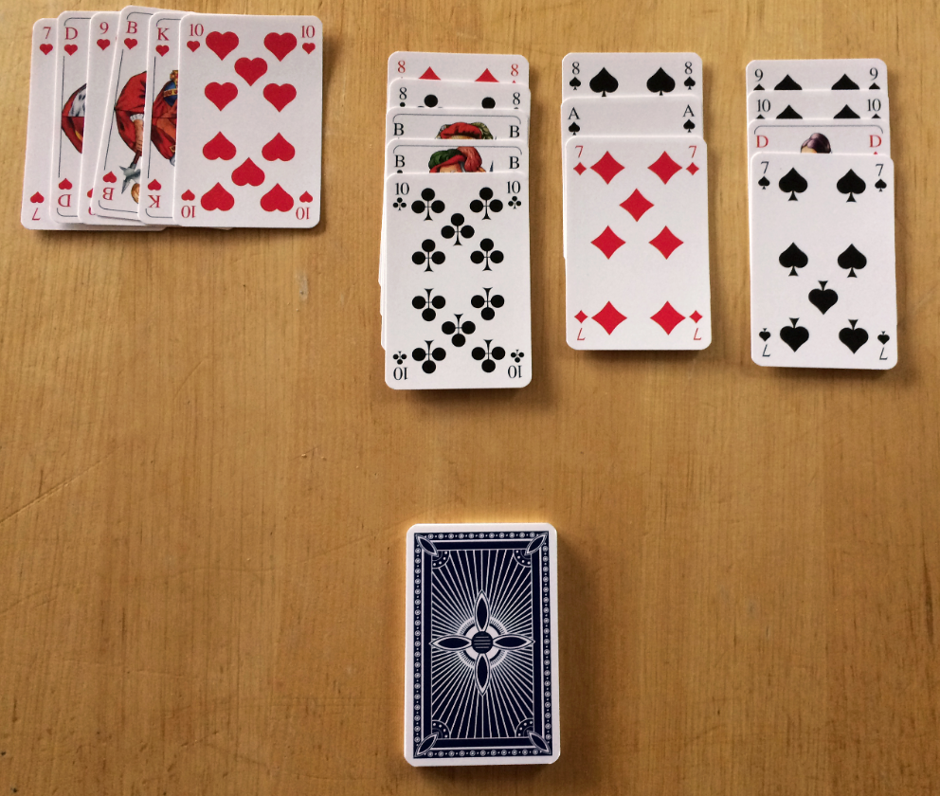
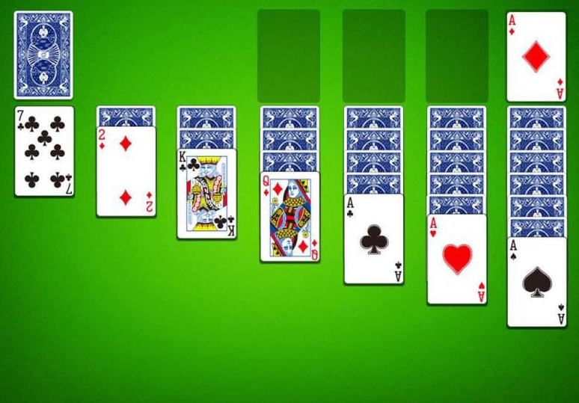
Inference and reflection
<number>

Slide 12
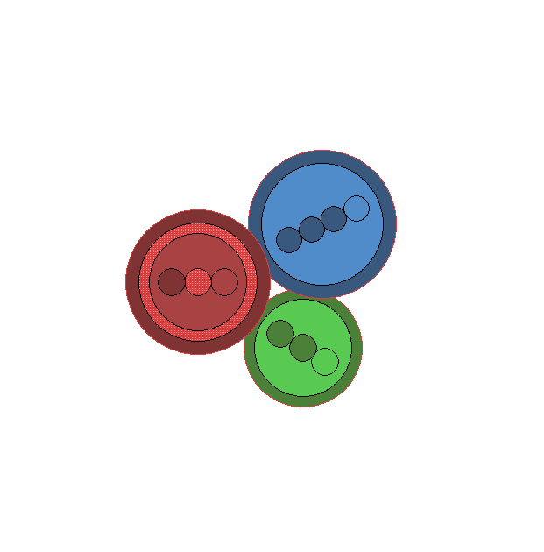
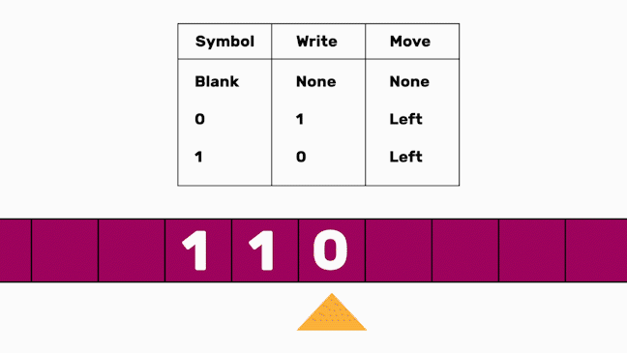
Computational models
Turing machine
λ-calculus
<number>

Slide 13
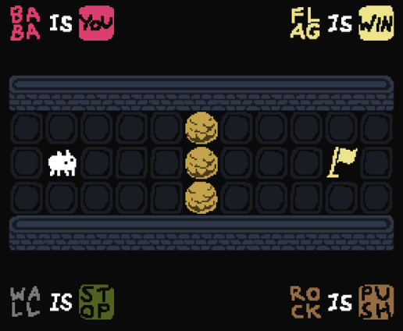
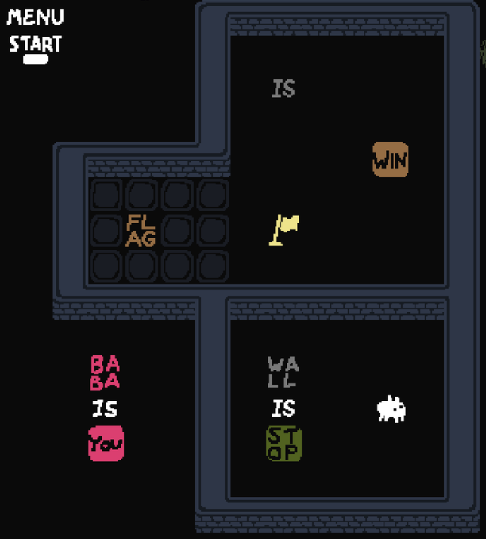
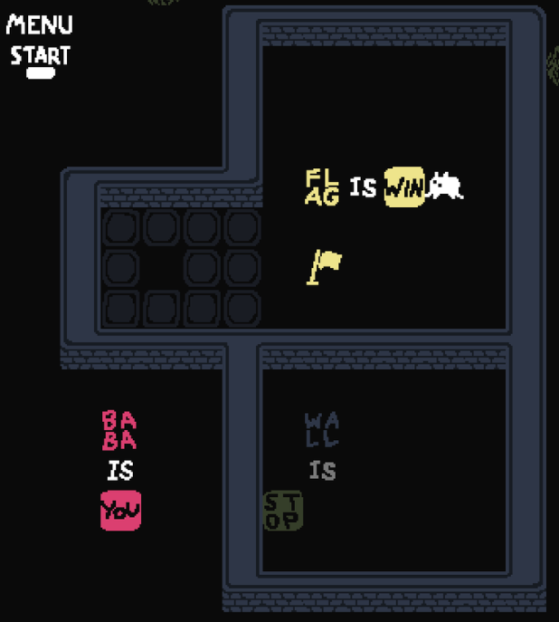
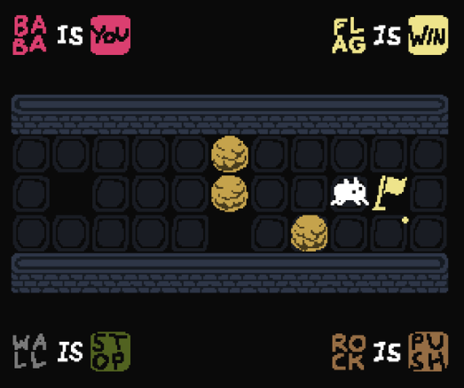
Fundamental concepts
<number>

Slide 14
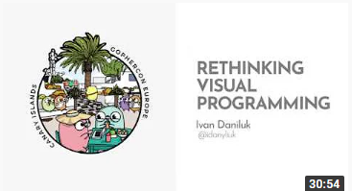
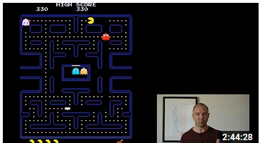
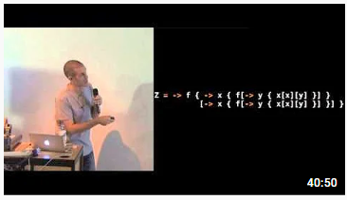
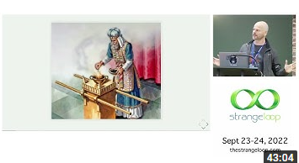
Food for thought
Rethinking visual programming, Ivan Danyliuk
Video games and the future of education,
Jonathan Blow
Programming with nothing,
Tom Stuart
Stop writing dead programs,
Jack Rusher
<number>

Slide 15
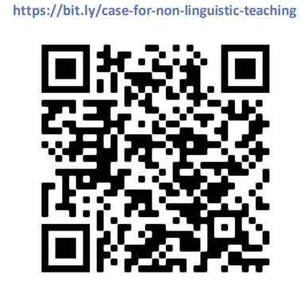
Presentation, links and references

